Slide 1
Introduction to HTML

Slide 2
HTML
Stands for HyperText Markup Language
Used to create a Web page
Made up of tags that specify the structure of the document (this section is a heading, this section is a paragraph, etc..)
An excerpt from a sample HTML document:
<html>
<head>
<title>Bob’s Web page</title>
</head>
<body>
<h1>This is my first Web page</h1>

Slide 3
HTML Tags
Most HTML tags work in pairs. There is an opening and a closing tag. For example:
<p>Some content here.</p>
The <p>…</p> tag displays a paragraph
<p> opens the paragraph (opening tag)
</p> closes the paragraph (closing tag)
“Some content here.” will be displayed on the page

Slide 4
How does HTML work?
HTML stands for HyperText Markup Language. "Markup language" means that, rather than using a programming language to perform functions, HTML uses tags to identify different types of content and the purposes they each serve to the webpage.

Slide 5
Example
Take a look at the article below.
If I were to ask you to label the types of content on the page, you'd probably do pretty well:
There's the header at the top,
then a subheader below it,
the body text,
and some images at the bottom
followed by a few more bits of text….

Slide 6
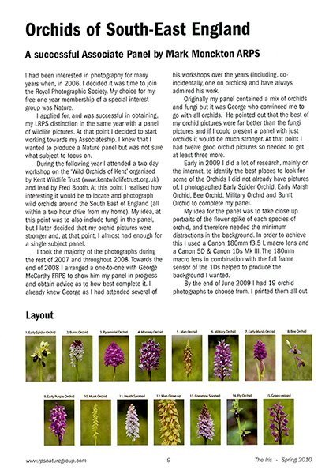

Slide 7
What is this?
Markup languages work in the same way as you just did when you labeled those content types, except they use code to do it -- specifically, they use HTML tags, also known as "elements." These tags have pretty intuitive names: Header tags, paragraph tags, image tags, and so on.
Every web page is made up of a bunch of these HTML tags denoting each type of content on the page. Each type of content on the page is "wrapped" in, i.e. surrounded by, HTML tags.

Slide 8
Self-closing Tags
Some HTML tags are self closing. For example:
<br />
The <br /> tag will display a line break.

Slide 9
Required Tags
All HTML documents should have html, head and body tags, along with the DOCTYPE identifier.
!DOCTYPE – Tells the browser which set of standards the page adheres to
<html>…</html> -- Surrounds the contents of the entire page
<head>…</head> -- Lists the identification information on the page, such as the title
<title>…</title> -- Gives the name of the page that appears in the top of the browser window
<body>…</body> -- Frames the content of the page to be displayed in the browser

Slide 10
Tags.. What they mean?
<!DOCTYPE HTML>: This special tag is used to inform the browser that
the document type is HTML. This is how the browser knows you’ll be
writing an HTML5 document. You will sometimes see other values for the doctype, but HTML5 is the way to go these days.

Slide 11
Language
<html lang = “en”></html>: The <html> tag is the foundation of
the entire web page. The tag begins the page. Likewise, </html> ends the page.
For example, the page begins with <html> and ends with </html>.
The <html></html> combination indicates that everything in the page is defined as HTML code.
In HTML5, you’re expected to tellthe browser which language the page will be written in.
Because we write in English, specifying with the code “en.”

Slide 12
Meta tag
<meta charset=“UTF-8”>: The meta tag is used to provide a little more information to the browser.
This command gives a little more information to the browser, telling it which character set to use.
English normally uses a character set called (for obscure reasons) UTF-8.

Slide 13
Comments .. Not for execution
<!--/-->: This tag indicates a comment, which is ignored by the browser.
However, a comment is used to describe what’s going on in a particular part of the code.

Slide 14
More on tags
<title></title>: This tag is used to determine the page’s title. The title usually contains ordinary text.
<body></body>: The page’s main content is contained within these tags.
<h1></h1>: H1 stands for heading level one.
<p></p>: p stands for the paragraph tag.

Slide 15
Basic Elements
A text header, denoted using the <h1>, <h2>, <h3>, <h4>, <h5>, <h6> tags.
A paragraph, denoted using the <p> tag.
A horizontal ruler, denoted using the <hr> tag.
A link, denoted using the <a> (anchor) tag.
A list, denoted using the <ul> (unordered list), <ol> (ordered list) and <li> (list element) tags.
An image, denoted using the <img> tag
A divider, denoted using the <div> tag
A text span, denoted using the <span> tag

Slide 16
Text headers and paragraphs
six different types of text header you can choose from, h1 being the topmost heading with the largest text, and h6 being the most inner heading with the smallest text.
In general, you should have only one h1 tag with a page, since it should be the primary description of the HTML page.

Slide 17
Example of Header –Save this and execute
<!DOCTYPE html>
<html>
<head>
</head>
<body>
<h1>My First Page</h1>
<p>This is my first page.</p>
<h2>A secondary header.</h2>
<p>Some more text.</p>
</body> </html>

Slide 18
Horizontal rulers
A horizontal ruler <hr> tag acts as a simple separator between page sections.
<!DOCTYPE html>
<html>
<head>
</head>
<body>
<h1>My First Page</h1>
<p>This is my first page.</p>
<hr/>
<p>This is the footer - all rights are reserved to me.</p>
</body>
</html>

Slide 19
Exercise
Add an HTML <h1> tag with the text "I'm the most important!"
Add an HTML <h2> tag with the text "I'm less important!"
Add an HTML <h6> tag with the text "I'm the least important!"

Slide 20
Text Formatting
Text formatting tags modify the text between the opening tag and the closing tag
Ex. <b>Hello</b> makes “Hello” bold
<b></b> | bold
<i></i> | italicized
<u></u> | underlined
<sup></sup> | Sample^{superscript}
<sub></sub> | Sample_{subscript}
<strong></strong> | strong
<em></em> | emphasized
<pre></pre> | Preformatted text
<blockquote></blockquote> | Quoted text block
<del></del> | Deleted text – strike through
20

Slide 21
Links
A link ("anchor") is a small span of text that will direct you to a different section in the page, or to a different page. To create a link, you will need to specify where you would like the user to be directed to when the link is clicked by specifying the href attribute.
For example:
<a href="https://www.google.com">A link to Google</a>
To create a link to a different section in the same page, you will need to use a hash sign along with the element ID to where you would like the browser to jump to.
For example:
<a href="#faq">Click here to read the Frequently Asked Questions</p>

Slide 22
Hyperlinks: <a> Tag (2)
Link to an external Web site:
Always use a full URL, including "http://", not just "www.somesite.com"
Using the target="_blank" attribute opens the link in a new window
Link to an e-mail address:
<a href="http://www.devbg.org" target="_blank">BASD</a>
<a href="mailto:bugs@example.com?subject=Bug+Report">
Please report bugs here (by e-mail only)</a>

Slide 23
Hyperlinks: <a> Tag
Link to a document called form.html on the same server in the same directory:
Link to a document called parent.html on the same server in the parent directory:
Link to a document called cat.html on the same server in the subdirectory stuff:
<a href="form.html">Fill Our Form</a>
<a href="../parent.html">Parent</a>
<a href="stuff/cat.html">Catalog</a>

Slide 24
Element ID
The element ID is denoted using the id attribute:
<h3 id="faq">Frequently asked questions
</h3>
<p>The first rule about fight club is that you do not talk about fight club.
</p>

Slide 25
Try this now…
<!DOCTYPE html>
<html> <head> </head> <body>
<h1>My First Page</h1>
<p>This is my first page.</p>
<a href="#faq">Click here to read the Frequently Asked Questions</a>
<hr/> <h3 id="faq">Frequently asked questions</h3>
<p>The first rule about fight club is that you do not talk about fight club.</p>
<p>However, if you do have questions, please e-mail me at foo@bar.com</p>
</body> </html>

Slide 26
Lists
HTML provides a way to create both an ordered list (with elements counting up, 1, 2, 3...) and an unordered list with bullets instead of numbers. Lists are a good way to formalize a list of items and let the HTML styling do the work for you.
Ordered lists
Here is an example of how to create an ordered list:
<p>Here is a list of ordered items:</p>
<ol>
<li>First item</li>
<li>Second item</li>
<li>Third item</li>
</ol>

Slide 27
Ordered Lists
Ordered lists have a "type" attribute which defines the numbering convention to use.
To count using numbers, use type="1":
<p>Here is a list of ordered items:</p> <ol type="1">
<li>First item</li>
<li>Second item</li>
<li>Third item</li>
</ol>

Slide 28
Types:
To count using uppercase letters, use type="A"
To count using lowercase letters, use type="a“
To count using uppercase roman numerals, use type="I“
To count using lowercase roman numerals, use type="i"

Slide 29
Unordered lists
Example to create an unordered list:
<p>Here is a list of unordered items:</p>
<ul>
<li>First item</li>
<li>Second item</li>
<li>Third item</li>
</ul>

Slide 30
Style attributes
To change the list style attributes, we can use the CSS attribute called list-style-type.
The available types are:
disc
circle
square
none
<p>Here is a list of unordered items:</p>
<ul style="list-style-type: disc">
<li>First item</li> <li>Second item</li> <li>Third item</li> </ul>

Slide 31
Definition lists: <dl> tag
Create definition lists using <dl>
Pairs of text and associated definition; text is in <dt> tag, definition in <dd> tag
Renders without bullets
Definition is indented
<dl>
<dt>HTML</dt>
<dd>A markup language …</dd>
<dt>CSS</dt>
<dd>Language used to …</dd>
</dl>

Slide 32
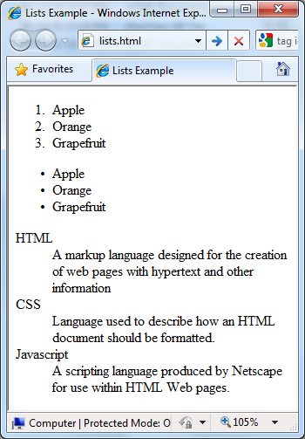
Lists – Example
lists.html
<ol type="1">
<li>Apple</li>
<li>Orange</li>
<li>Grapefruit</li>
</ol>
<ul type="disc">
<li>Apple</li>
<li>Orange</li>
<li>Grapefruit</li>
</ul>
<dl>
<dt>HTML</dt>
<dd>A markup lang…</dd>
</dl>

Slide 33
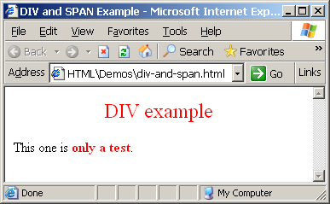
The <div> Tag
<div> creates logical divisions within a page
Block style element
Used with CSS
Example:
div-and-span.html
<div style="font-size:24px; color:red">DIV example</div>
<p>This one is <span style="color:red; font-weight:bold">only a test</span>.</p>

Slide 34
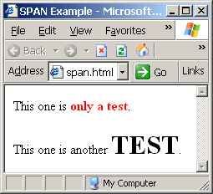
The <span> Tag
Inline style element
Useful for modifying a specific portion of text
Don't create a separate area (paragraph) in the document
Very useful with CSS
span.html
<p>This one is <span style="color:red; font-weight:bold">only a test</span>.</p>
<p>This one is another <span style="font-size:32px; font-weight:bold">TEST</span>.</p>

Slide 35
Images
Images in HTML are inline elements that can be placed within a paragraph. To add an image, use the <img> tag along with the src attribute to specify the location of the image.
<img src="/static/img/code.jpg">
<img src="/static/img/code.jpg" width="100"> <img src="/static/img/code.jpg" style="width: 100px">

Slide 36
Image Types
There are three main types of image formats:
Lossless formats - useful for when you need pixel-perfect graphics, for example for logos. The most common format is PNG.
Lossy formats - useful for displaying rich images. The most common format used in this category is JPG
Animated formats - useful for showing short animated images. The most common format is GIF

Slide 37
Images: <img> tag
Inserting an image with <img> tag:
Image attributes:
Example:
<img src="/img/basd-logo.png">
src | Location of image file (relative or absolute)
alt | Substitute text for display (e.g. in text mode)
height | Number of pixels of the height
width | Number of pixels of the width
border | Size of border, 0 for no border
<img src="./php.png" alt="PHP Logo" />
37

Slide 38
HTML- Image Maps
Image with clickable areas.
<map> tag - define a client-side image-map.
attribute of the <map> element is associated with the <img>'s usemap attribute and creates a relationship between the image and the map.
The <map> element contains a number of <area> elements, that defines the clickable areas in the image map.

Slide 39
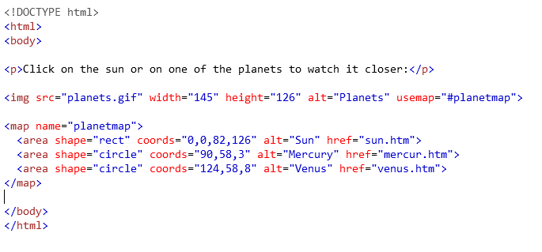
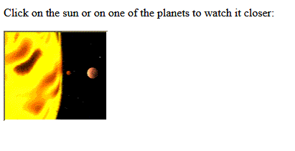

Image Map- Example
Clicking on Larger Circle --→

Slide 41
Exercise
Add a image within the body, tag with the image "photo.jpg".
Adjust size of img to 100px by 100px
Add onload command, onload="alert('')" with the text "task complete"

Slide 42
Basic HTML Template
<!DOCTYPE html>
<html>
<head>
<title>CMSC104 HTML Template</title>
</head>
<body>
This is just a basic HTML template to be used in CMSC104.
</body>
</html>
Example file: template.html

Slide 43
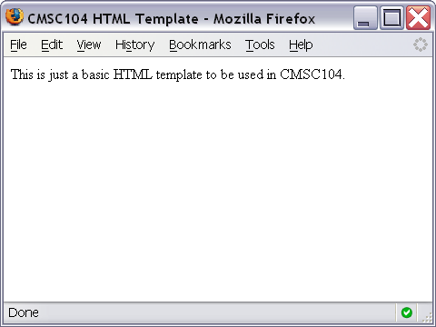
Basic HTML Template Screenshot

Slide 44
Some Common HTML Tags and Their Meanings
<p>…</p> -- Creates a paragraph
<br /> -- Adds a line break
<hr /> -- Separates sections with a horizontal rule
<h1>…</h1> -- Displays a heading (h1-h6)
<!--…--> -- Inserts a comment
<ol>…</ol> -- Creates an ordered list
<ul>…</ul> -- Creates an unordered list
<img /> -- Inserts an image into the document
<a>…</a> -- Inserts a link into the document

Slide 45
Paragraph Example
<p>
The exam next week will consist of T/F, multiple choice, short answer and pseudocode questions. You cannot use a calculator.
</p>
<p>
After the exam, we will learn JavaScript. It should be fun!!
</p>

Slide 46
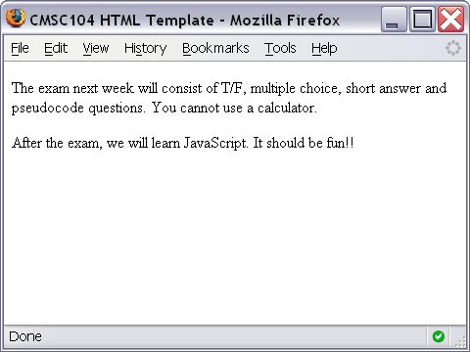
Paragraph Example Screenshot

Slide 47
Line Break Example
<p>
Roses are Red. <br />
Violets are Blue. <br />
You should study for Exam 1. <br />
It will be good for you!
</p>

Slide 48
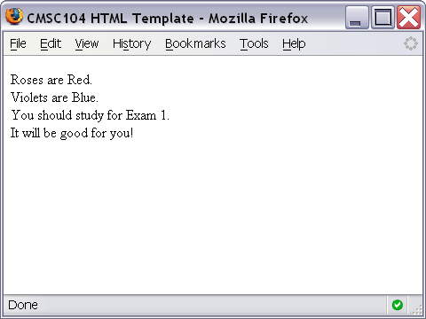
Line Break Example Screenshot

Slide 49
Horizontal Rule Example
<p>
The exam next week will consist of T/F, multiple choice, short answer and pseudocode questions. You cannot use a calculator.
</p>
<hr />
<p>
After the exam, we will learn JavaScript. It should be fun!!
</p>

Slide 50
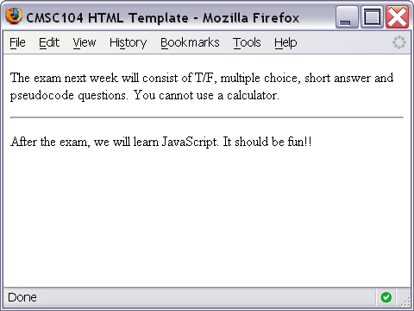
Horizontal Rule Example Screenshot

Slide 51
Heading Example
<h1>This is heading 1</h1>
<h2>This is heading 2</h2>
<h3>This is heading 3</h3>
<h4>This is heading 4</h4>
<h5>This is heading 5</h5>
<h6>This is heading 6</h6>

Slide 52
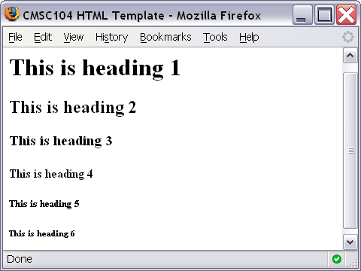
Heading Example Screenshot

Slide 53
Comment Example
<!-- This is just some sample html to illustrate the use of a comment -->
<p>
Here is my paragraph.
</p>
<!-- Here is another comment -->

Slide 54
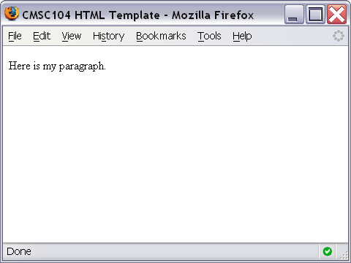
Heading Example Screenshot

Slide 55
Ordered List Example
<ol>
<li>Print Review Questions for Exam 1.</li>
<li>Work on Review Questions for Exam 1.</li>
</ol>

Slide 56
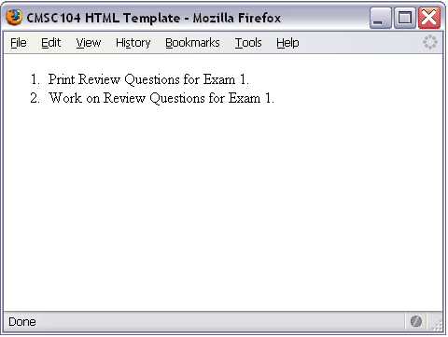
Ordered List Screenshot

Slide 57
Unordered List Example
<ul>
<li>country music</li>
<li>monday mornings</li>
<li>brussels sprouts</li>
</ul>

Slide 58
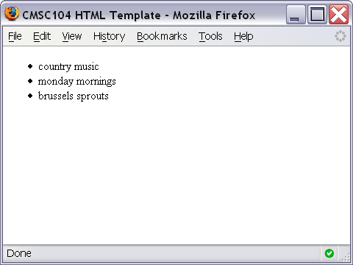
Unordered List Screenshot

Slide 59
Link Example
<a href="http://www.cs.umbc.edu/104/">CMSC104 Main page</a>

Slide 60
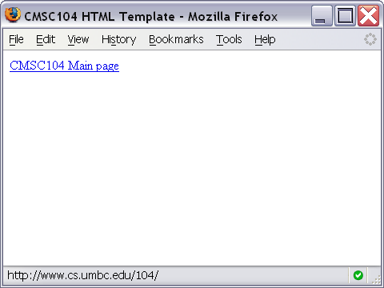
Link Screenshot

Slide 61
Image Example
<img src="linux-tux.png" alt="Tux the Penguin" />

Slide 62
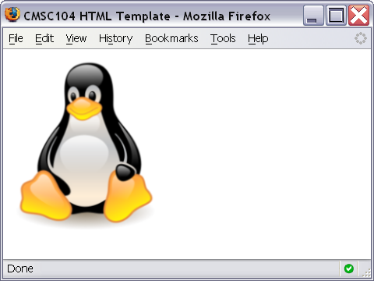
Image Screenshot

Slide 63
Validating your web pages
Introducing the concept of valid pages
Using a doctype
Setting the character set
Meeting the W3C validator
Fixing things when they go wrong
Using HTML Tidy to clean your pages

Slide 64
Pointers for validation
All tags have endings.
Tags can’t be overlapped
Everything’s lowercase
Attributes must be in quotes
Layout must be separate from markup (css – we shall see later)

Slide 65
Online validator
You can validate your code using W3C validator at http://validator.w3.org
A validator is actually the front end of a piece of software that checks pages for validity. It looks at your web page’s doctype and sees whether the page conforms to the rules of that doctype. If not, it tells you what might have gone wrong.

Slide 66
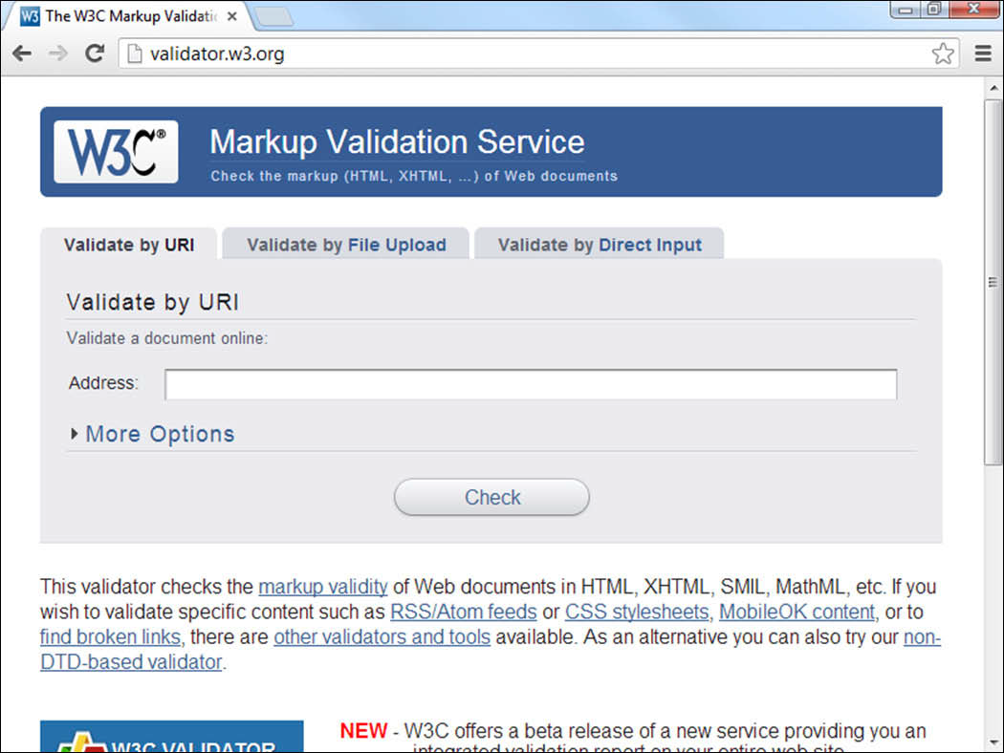

Slide 67
Methods
Validate by URI - this option is used when a page is hosted on a web server. Files stored on local computers can’t be checked with this technique.
Validate by file upload. This technique works fine with files you haven’t posted to a web server. It works great for pages you write on your computer but that you haven’t made visible to the world. This is the most common type of validation for beginners.
Validate by direct input. The validator page has a text box you can simply paste your code into. It works, but I usually prefer to use the other methods because they’re easier.

Slide 68
Working Example
To see an example page that uses all of the tags we discussed today, visit
http://userpages.umbc.edu/~dblock/lecture6.html

